Slide 1
BOOK A DOCTOR USING MERN
TEAM MEMBERS
SHRUTHI S
SHREEPRIYADARSHINI RM
JENNEFER J
YUVASRI S

Slide 2
ABSTRACT
The "Book a Doctor using MERN" project is a web application designed to simplify the process of scheduling doctor appointments online.
It offers a user-friendly platform that allows patients to browse through a list of doctors, view their availability, and book appointments at their convenience.
The system is built using the MERN stack (MongoDB, Express, React, Node.js),providing a robust and scalable solution for both Clients and healthcare providers.

Slide 3
INTRODUCTION
The healthcare industry has seen a significant shift towards digitalization in recent years.
With the increasing demand for online services, there is a need for a platform that enables patients to book doctor appointments online.
The "Book a Doctor using MERN" project aims to fill this gap by providing a user-friendly and efficient platform for patients to book doctor appointments.

Slide 4
EXISTING SYSTEM
The existing system for booking doctor appointments is traditional system, which is manual and time-consuming.
Patients have to visit the hospital or clinic in person to book an appointment, where they often face long waiting times.
This manual process can lead to delays, miscommunication, and errors in scheduling.
Additionally, paper-based records can be challenging to maintain and track and some existing online systems lack interactivity and may not provide real-time availability of doctors.

Slide 5
PROPOSED SYSTEM
The proposed system will be built using the MERN stack
User-friendly interface:
Patients can easily search for doctors by specialization, location, or availability.
Real-time scheduling:
Patients can view available time slots and book appointments in real-time.
Doctor management:
Doctors can update their schedules, view upcoming appointments, and manage availability.

Slide 6
Data storage:
Patient and appointment data are securely stored in a MongoDB database.
View appointment history page:
The Patient can view their history of appointments made for future references.
Cancel or reschedule appointments page:
Patients can cancel or reschedule the appointments based on their availability.

Slide 7
FUTURE IMPLEMENTATIONS
Video Consultations
Patient Medical History
Mobile Application
Multilingual Support

Slide 8
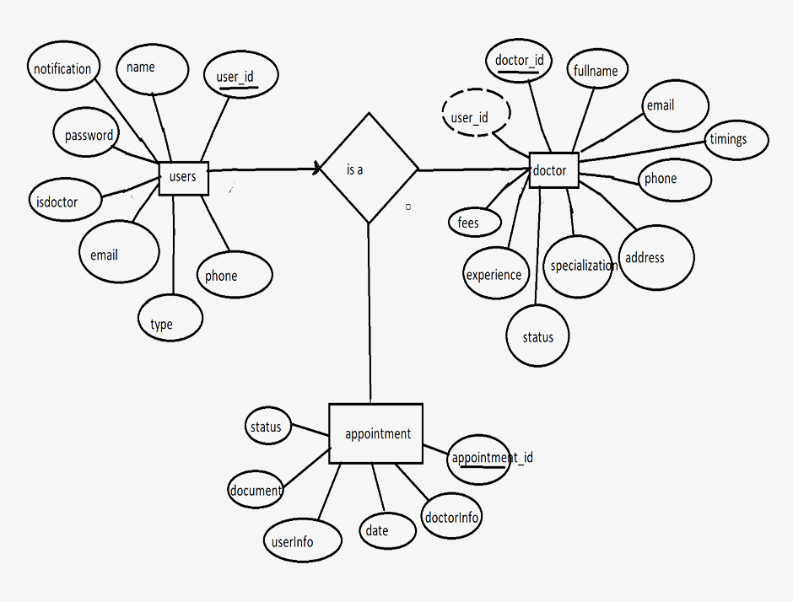
ER DIAGRAM

Slide 9
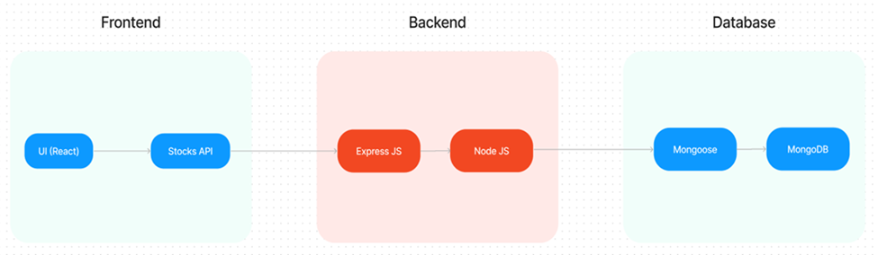
ARCHITECTURE DIAGRAM

Slide 10
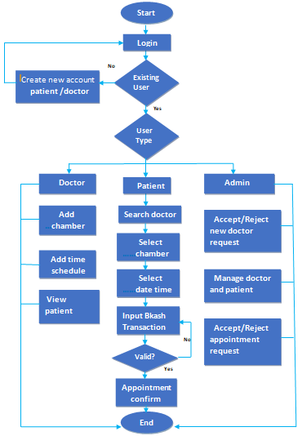
FLOW DIAGRAM

Slide 11
FRONT-END DEVELOPMENT
The frontend is built using React.js to create a responsive and interactive user interface.
Technologies Used:
React , HTML, CSS, Bootstrap.
React components handle the appointment scheduling process and user interactions dynamically. It includes components like the doctor search page, appointment booking form, and user login/signup features.
JWT (JSON Web Tokens) is implemented to provide secure login and authentication.
Features like real-time status updates and notifications are implemented using React's state management.

Slide 12
BACK-END DEVELOPMENT
The backend of the Doctor Appointment System is built using Node.js and Express.js, providing the core functionality for managing appointments, user data, and communication between the frontend and database.
API Development with Express.js:
The backend follows a RESTful architecture, offering endpoints to handle requests such as appointment booking, user registration, login, and retrieving doctor information.
Endpoints are structured for operations like GET (fetch doctor list, appointments), POST (register, book appointments), PUT (update doctor availability), and DELETE (cancel appointments).

Slide 13
BACK-END DEVELOPMENT
Non-blocking, Asynchronous Processing with Node.js:
Node.js uses an event-driven, non-blocking I/O model, which allows it to handle multiple client requests simultaneously without slowing down.
It handles the backend API calls, interacting with the database (MongoDB) to perform CRUD operations (Create, Read, Update, Delete)
CRUD operations are performed for tasks like appointment booking, managing doctor availability, and user authentication.

Slide 14
BACK-END DEVELOPMENT
Database Management (MongoDB):
MongoDB is used as the NoSQL database to store data like patient profiles, doctor details, appointments, and schedules.
Data is organized into collections (e.g., Users, Doctors, Appointments) and handled through Mongoose, a MongoDB ODM (Object Data Modeling) library.
Mongoose provides schemas to validate data and ensures smooth interactions with MongoDB.

Slide 15
INTEGRATION
The frontend (React.js) interacts with the backend through RESTful APIs. React makes GET and POST requests to the server, which processes data and returns appropriate responses.
The backend communicates with MongoDB using Mongoose for managing doctor profiles, appointments, and user data. API requests fetch and update this data in real-time.
The backend uses JWT tokens for secure user authentication. When users log in or sign up, their credentials are validated, and a token is returned to allow access to protected routes.

Slide 16
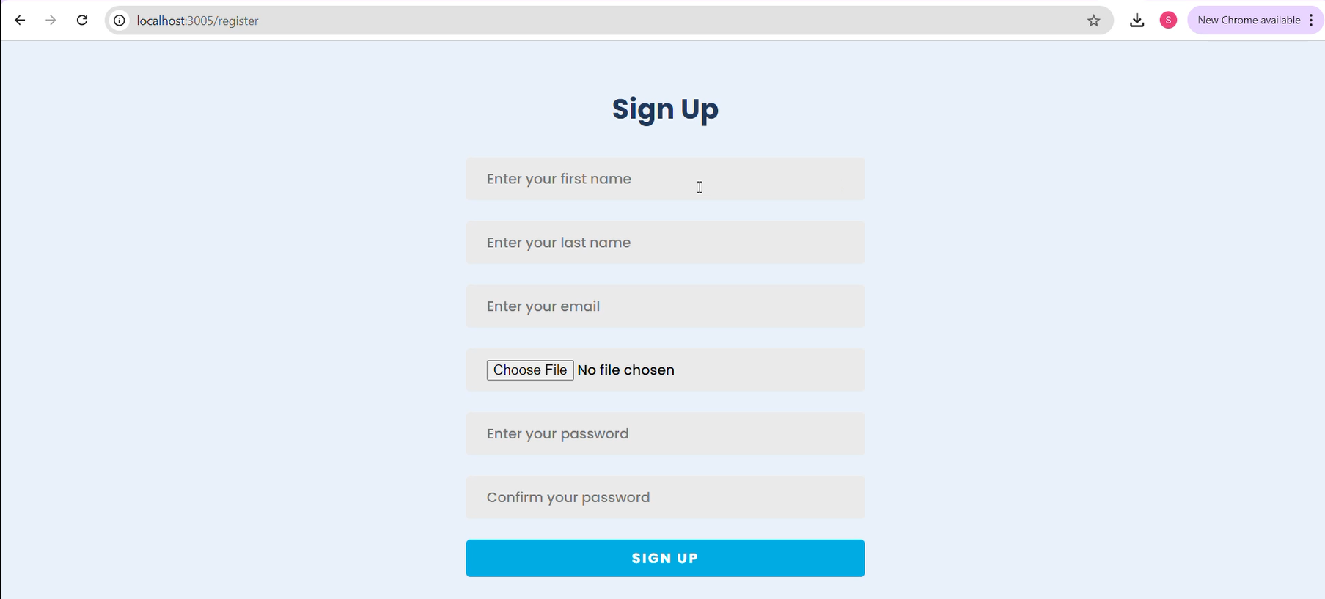
MODEL
REGISTRATION PAGE

Slide 17
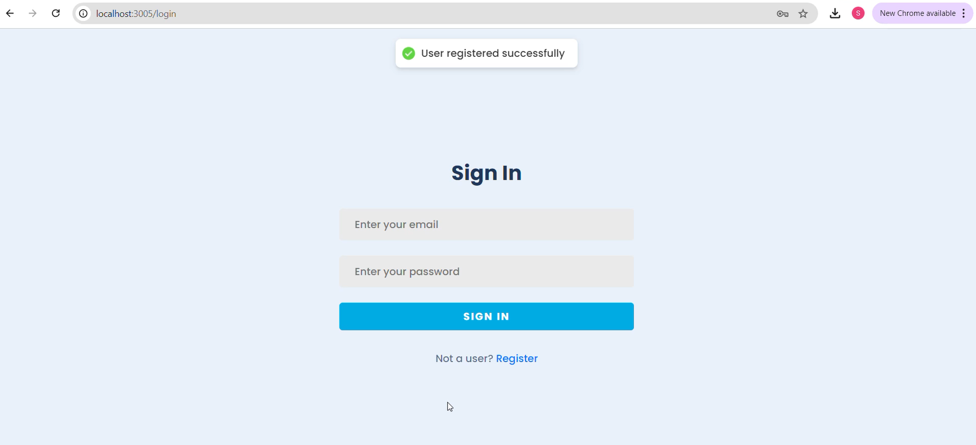
LOGIN PAGE

Slide 18
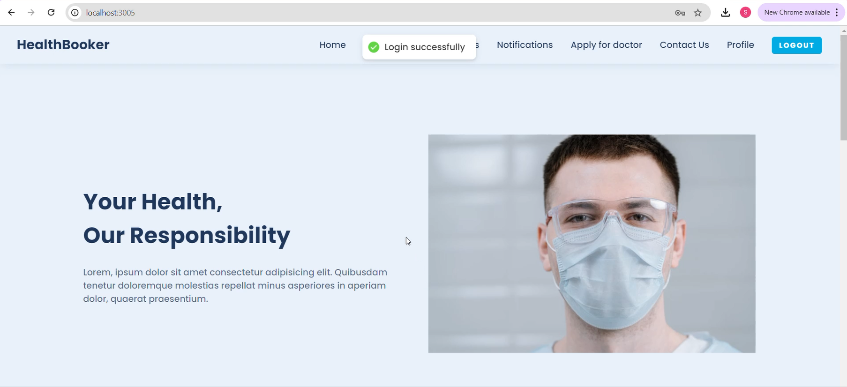
HOME PAGE

Slide 19
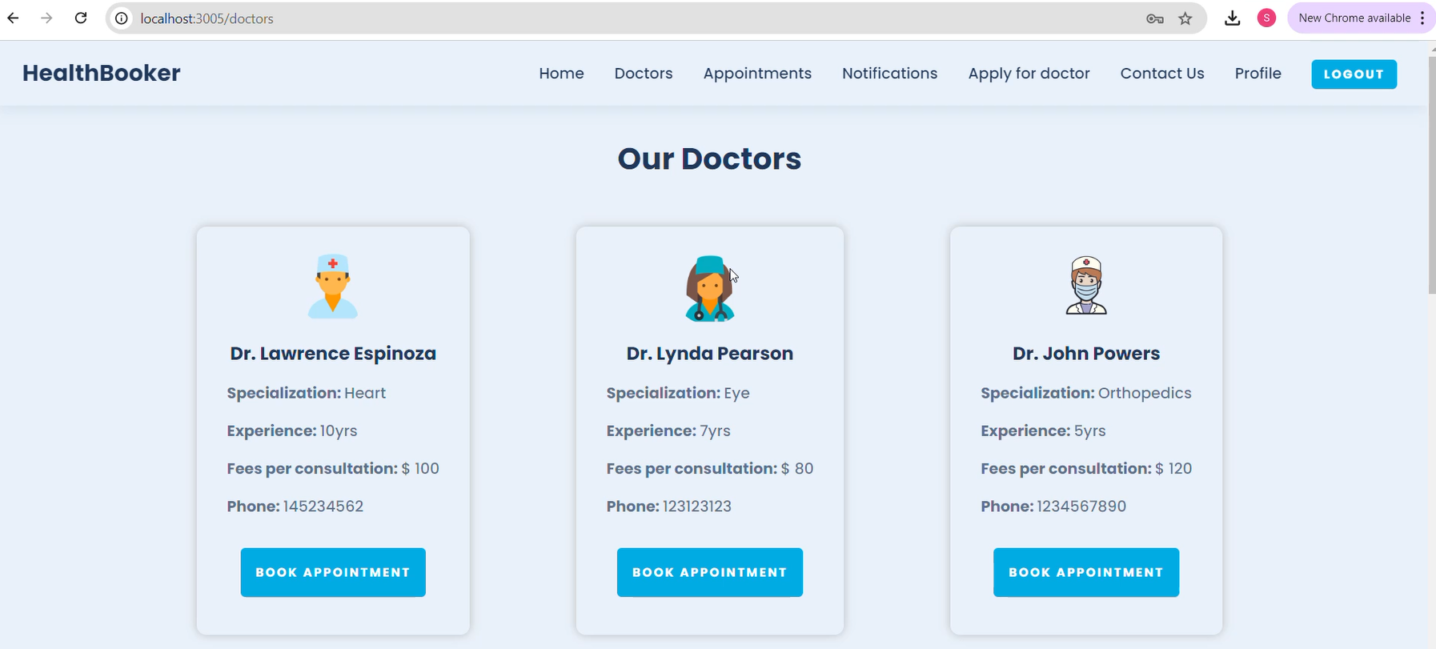
DOCTORS PAGE

Slide 20
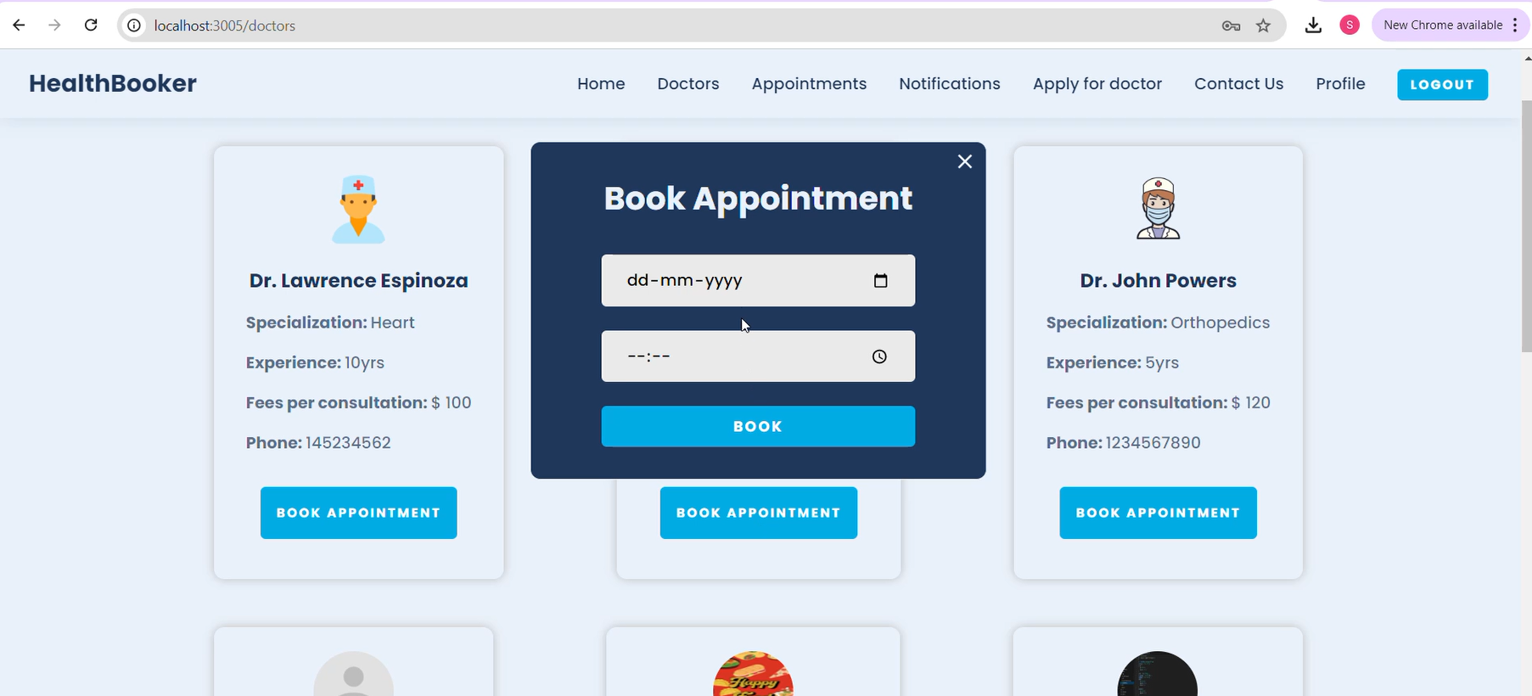
APPOINTMENT PAGE

Slide 21
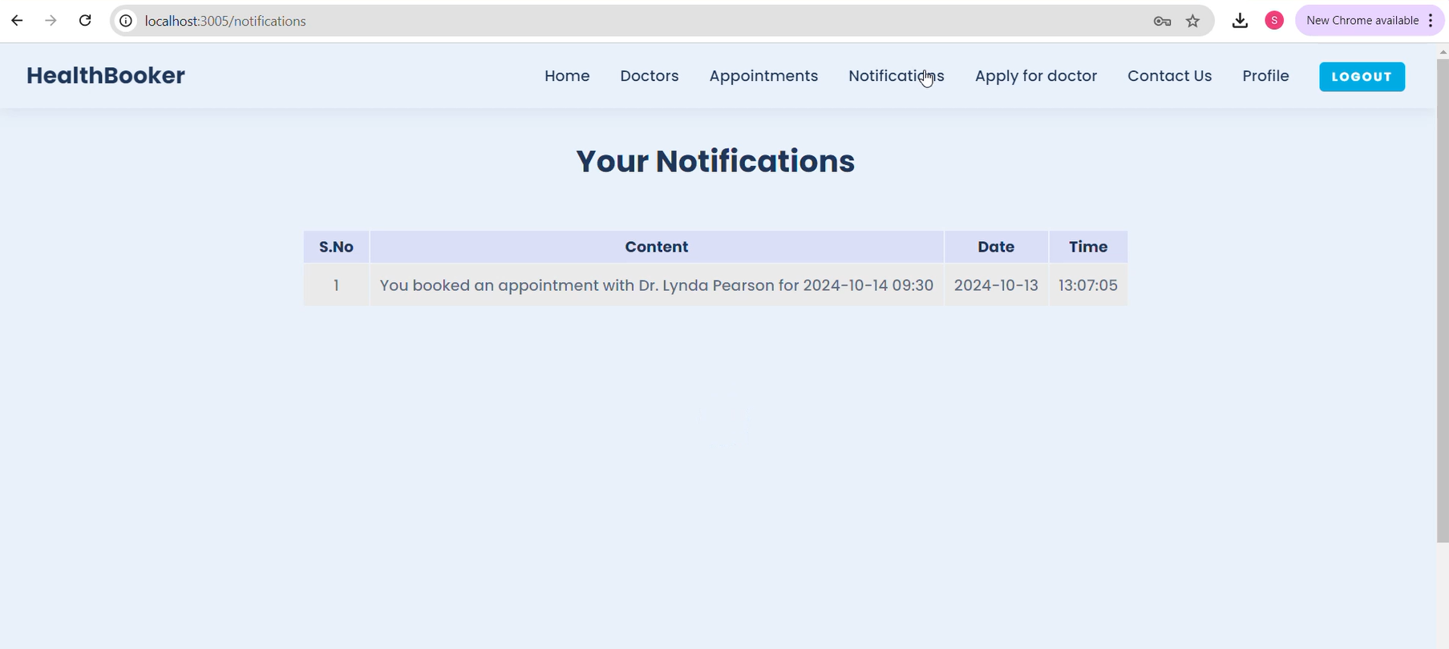
NOTIFICATIONS PAGE

Slide 22
CONCLUSION
This project “BOOK A DOCTOR USING MERN” offers a robust solution to modernize the appointment scheduling process. It is built using scalable web technologies that enhance the patient experience and streamline doctor workflows.
It exemplifies how the MERN stack can be used to develop responsive and efficient web applications in the healthcare sector.

Slide 23
THANK YOU

